Slide 1

RAJEEV GANDHI MEMORIAL COLLEGE OF ENGINEERING & TECHNOLOGY
(AUTONOMOUS)
Approved by AICTE, New Delhi; Affiliated to JNTUA-Ananthapuramu,
Accredited by NBA (6-Times); Accredited by NAAC with ‘A+’ Grade (Cycle-3), New Delhi;
World Bank Funded Institution; Nandyal (Dist)-518501, A.P
(Estd-1995)
DEPARTMENT OF COMPUTER SCIENCE AND ENGINEERING (DATA SCIENCE)
Under the guidance of
Dr. Penchala Prasad
Associate Professor
Department of CSE(DS)

Slide 2
BANKING : Customer Churn Prediction
Team Members
1 Anvitha Dadireddy (23091A3211)
2 Arif Molla (23091A3213)

Slide 3
IntrodUCtion
Customer churn is a major challenge faced by the banking industry
Churn occurs when customers stop using a bank’s services and move to competitors
High customer churn leads to loss of revenue and affects long-term business growth
Increasing competition in the financial sector makes customer retention critical
Banks need to identify potential churn customers at an early stage
Machine learning techniques help analyze customer behavior patterns
Predicting churn in advance enables banks to take preventive retention actions

Slide 4
Objectives
Applying Exploratory Data Analysis (EDA)
Use Decision Tree for feature selection
Identify Most Important Feature
Train Model
Use Gradient Boosting for error reducing
Evaluate Model using Accuracy

Slide 5
Data set overview
Features :
customer_id
credit_score
country
gender
age
tenure
Balance
credit_card
active_member
estimated_salary
churn

Slide 6
Data Preprocessing
Handle missing values
Encode categorical data
Remove irrelevant features
Prepare data for modeling

Slide 7
Exploratory Data Analysis (EDA)
Churn Distribution
Churn vs Gender
Churn vs Country
Churn vs Active Status

Slide 8
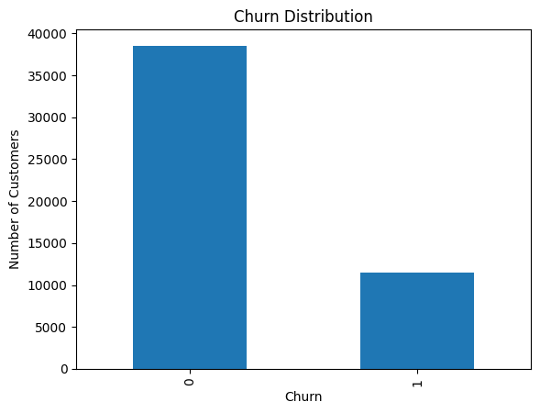
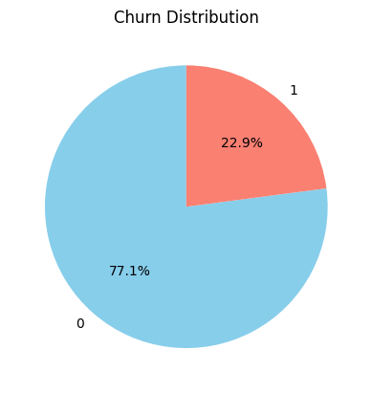
Churn distribution

Slide 9
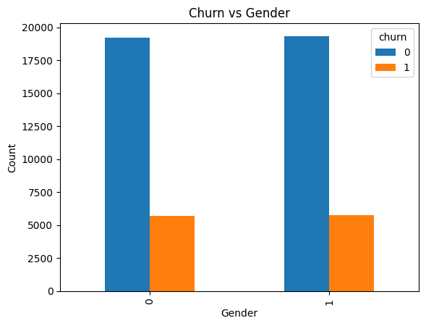
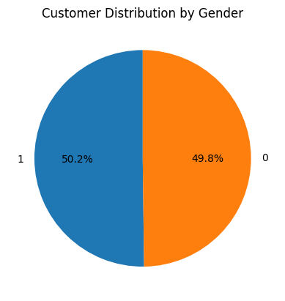
Customer vs gender

Slide 10
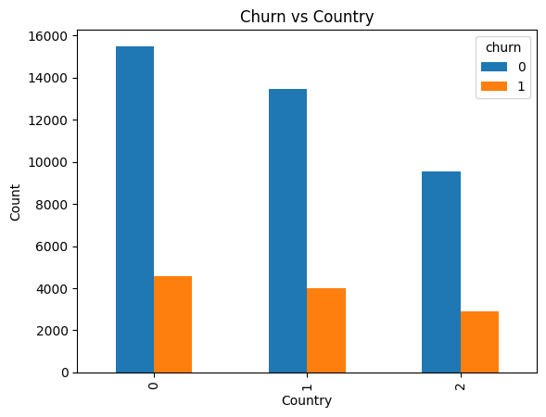
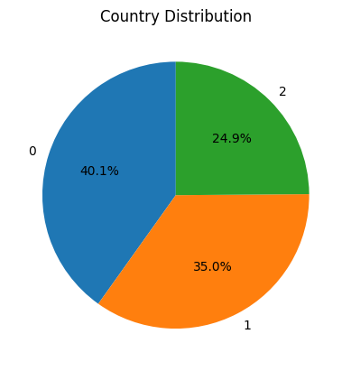
Customer vs country
COUNTRY DISTRIBUTION

Slide 11
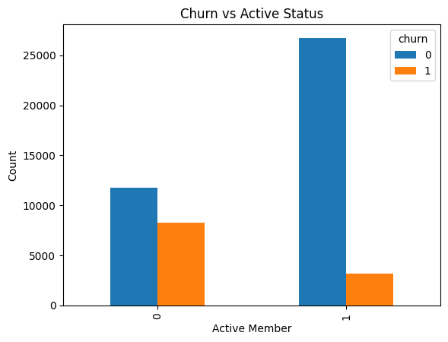
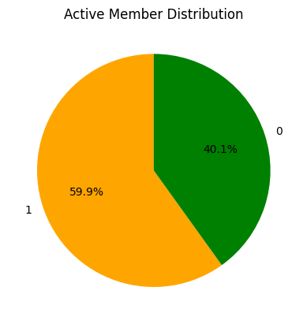
Customer vs active status
ACTIVE STATUS DISTRIBUTION

Slide 12
Decision tree
Used for Automatic feature selection
Select Based on Feature Importance
Important features are identified without manual bias.
Gini :
* Mixed
* Range
* Goal

Slide 13
Model Development & Training Approach
Decision Tree used for automatic feature selection based on Gini impurity
Selected important features used to train the final models
Dataset split into training and testing sets for proper evaluation
MODELS IMPLEMENTED
SGDClassifier (Logistic Regression)
Uses Gradient Descent optimization
Serves as baseline linear model
Random Forest Classifier
Ensemble of multiple decision trees
Reduces overfitting and improves stability
Gradient Boosting Classifier
Sequential learning approach
Corrects previous errors
Improves overall prediction accuracy

Slide 14
Logistic regression using gradient descent
SGDClassifier with loss="log_loss"
Implements Logistic Regression
Optimized using Stochastic Gradient Descent (SGD)
Predicts probability using Logistic function
Calculates error (log loss)
Updates weights using Gradient Descent
Repeats until convergence (max_iter = 1000)

Slide 15
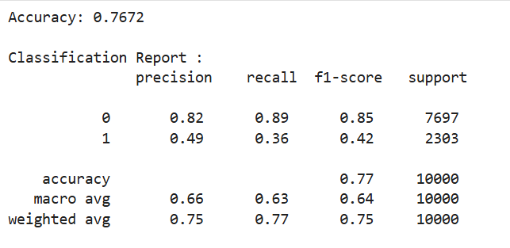
STOCHASTIC GRADIENT DESCENT Accuracy and confusion matrix

Slide 16
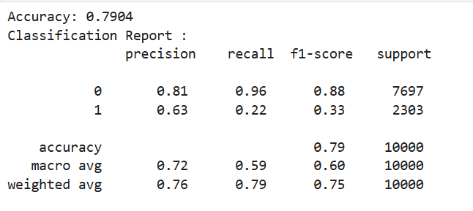
Random forest Accuracy and confusion matrix

Slide 17


